Slide 2
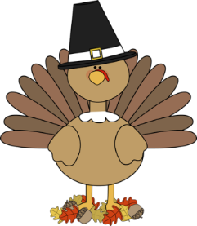
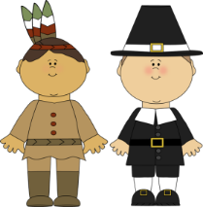
November
Tyson’s Tykes are a
Thankful Bunch!
ELA News
We are into the swing of things in Theme 3. In the next few weeks, we will be working on the following:
Digraph /th/th blends with r
Short vowel /u/u contraction ‘ll
Diphthong /ng/ng listening for details
Blends with s plot (events in a story)
Math
We have finished Chapter 3 addition to 10 and will be testing Chapter 4 subtraction to 10 the first full week in November. We will do a quick chapter lesson to review our shapes and how to classify them. Then we will dive into number to 20, learning about their place values and how to order them. After that we will go back into addition and
subtraction with sums to 20. Wow,
We are getting into the grove of this
New math program and moving along nicely.
Writing
In writing, we have been talking about what a good sentence consist of. We are working on making sure we start out sentences with a capital letter and ends with a period. We have gotten better at our words spacing and using lower case letters! Please encourage your child to write at home.
Science/ Social Studies
This month we will be learning about Thanksgiving and being thankful. We are looking forward to giving thanks on
November 24th!!
Reminders: Special Schedule
NO school Tuesday 11/8 and 11/22-11/25 Thanksgiving holiday Monday - Music
Education Visit day – Wed. 11/18 Tuesday - Art
11/22 and 11/23 – conferences – return form ASAP Wednesday – Gym
Thursday – Gym
Friday – Library
Contact information: etyson@methacton.org
Birthdays
Delany Rotella – 25th
Aditi Prakash – 27th

